Slide 1
The Korean War

Slide 2
The Korean War
Containment: The policy of preventing the expansion of a hostile power.

Slide 3
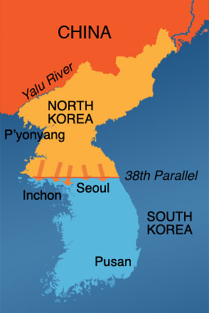
The Korean War
During World War II, Japan controlled Korea.
After World War II, the USSR controlled the North and the U.S. controlled the South.

Slide 4
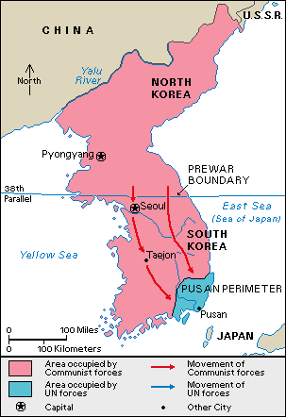
The Korean War
When trying to reunify Korea, the Communist North invades the South. UN forces are pushed to the city of Pusan.

Slide 5
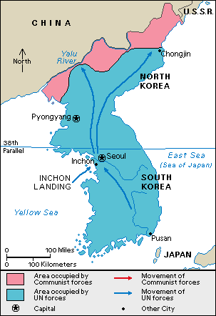
The Korean War
UN forces led by General Douglas MacArthur land at the city of Inchon and force North Korean troops back North to the Yalu River.

Slide 6
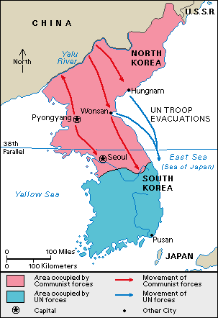
The Korean War
The Chinese, worried about the advancing U.N. troops, decide to join the war and push U.N. forces back behind the 38th parallel.

Slide 7
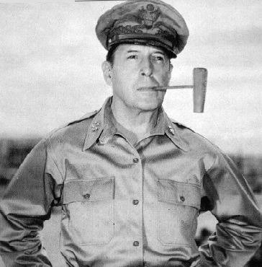
The Korean War
With China entering the war, MacArthur wanted to use nuclear weapons.
Truman did not.
MacArthur publicly criticized President Truman and Truman fired him.
Limited War: A war fought with a limited amount of resources to achieve an objective

Slide 8
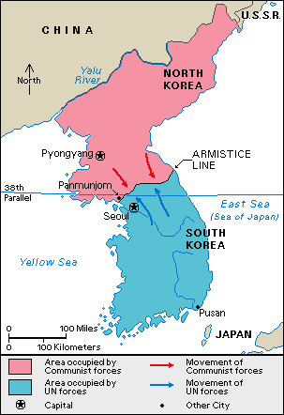
The Korean War
The UN forces pushed the Chinese forces back and this is the boundary.
There was a cease fire agreement signed, but the war is not over.
After 3 years of fighting it was a stalemate.

