Slide 1
My Business

Slide 2
Day 1: My Business
In groups of no more than 4:
Decide on a business to start
List all of the resources you will need. Some things to consider: human resources, natural resources, financial resources, machinery, technology, factories, plants

Slide 3
Day 2: Capital
Pick the type of business you are going to start. Either:
Sole Proprietorship
Partnership
Large Companies/corporations
How are you going to get the money?

Slide 4
Day 3: Create a flow chart

Slide 5
Day 3: Create a flow chart
What does the word Vertical mean?

Slide 6
Day 3: Create a flow chart
What does the word Vertical mean?
What does the word Horizontal mean?

Slide 7
Day 3: Create a flow chart
SO… what does Vertical integration mean?

Slide 8
Day 3: Create a flow chart
SO… what does Vertical integration mean?
What does Horizontal integration mean?

Slide 9
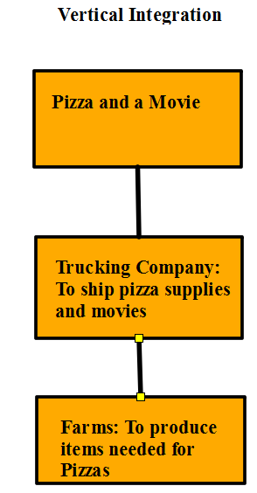
Day 3: Create a flow chart

Slide 10
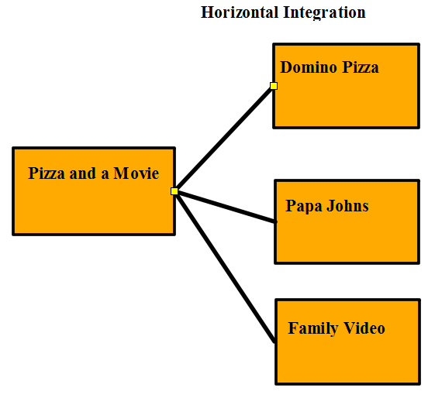
Day 3: Create a flow chart

Slide 11
Day 3: Create a flow chart
Create your own flow chart based on the business you have and use either vertical or horizontal integration to create it.

Slide 12
Day 4:Unions
What is a Union?
How does it work?

Slide 13
Day 4: Unions
Your employees have formed a Union and are demanding better working conditions, pay, and benefits. What does this mean to your company?
Things Unions bargan: Wages, hours vacations, Insurance, Holidays, Overtime, Seniority, Health and safety issues, Evaluation, lay offs, training, and Grievances.

Slide 14
Day 4: Unions
The employees want:
Pay raise from $7.25 to $10.00
Double time pay for holidays and overtime
6 paid holidays
A 10 minute break every hour
1 hour paid lunch
You have 1000 full time employees

Slide 15
Day 5: Final Business Plan
Paragraph 1: Describe the business you wish to start. What does it provide, what will you need, how many employees will it hire, etc.
Paragraph 2: Describe the type of business you will create, Sole Proprietor, partnership, or corporation and how will you raise the money to pay for the start up.
Paragraph 3: How will you use Vertical or horizontal integration to expand your business
Page 2 Flow Chart

