Slide 1
Mining, ranching and farming
The old west

Slide 2
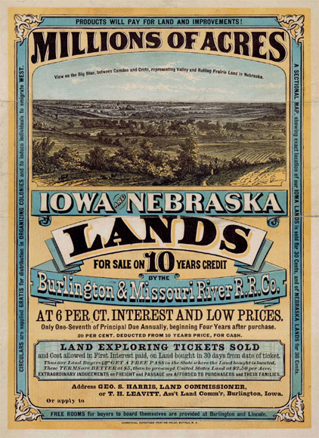

Slide 3
Assignment
Create your own flier to go west
Choose farming, ranching, or mining as a reason to go west
Choose a state or region to travel to.
On the flier, show how technology will impact your occupation (seed drill, metal plow, barb wire, sleuice mining, etc)
On the flier, show how population growth, will change the West. (Be the first to get the best land)
Give incentives to move west.

