Slide 1
End of the War In Europe

Slide 2
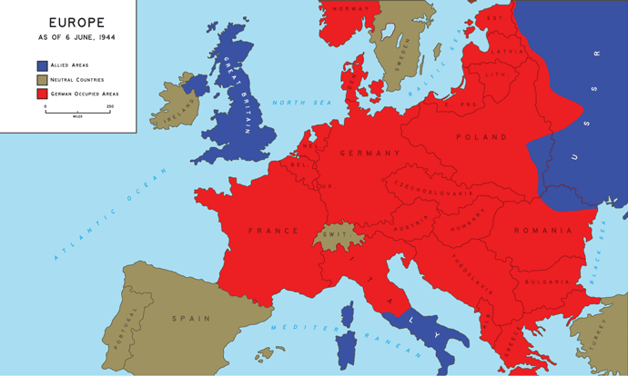
Map of Europe As of D-Day

Slide 3
End of World War II in Europe
After the Battle of the Bulge, the Germans lost ground fast.
D-Day: June 1943
Battle of the Bulge: December 1944
FDR has a stroke: April 12, 1945
Hitler commits suicide: April 30,1945
V-E Day: May 1945

