Slide 1
The Battle of the Bulge

Slide 2
The Battle of the Bulge
Since D-Day, Germany had been slowly loosing
Hitler decided to make one last offensive attack

Slide 3
The Battle of the Bulge
December 16, 1944
During a snow storm
6 inches of snow
Temperature below zero

Slide 4
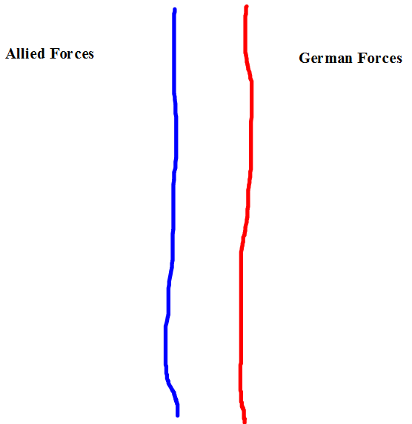
The Battle of the Bulge
Before the attack

Slide 5
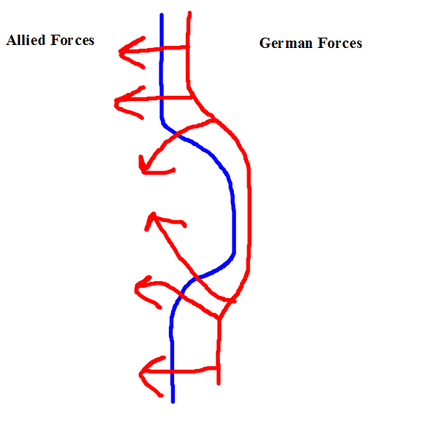
The Battle of the Bulge
The German Attack

Slide 6
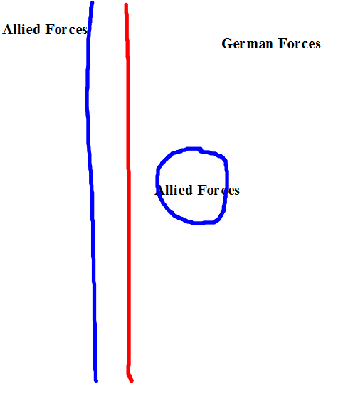
The Battle of the Bulge
After the German Attack

Slide 7
The Battle of the Bulge
The 101st Airborne were surrounded
Waiting for the weather to clear, U.S. General Patton attacks
On January 8th, Germany retreats
Germany suffered over 100,000 casualties
Lost many tanks and aircraft

