Slide 1
Laws of Migration

Slide 2
Definition
To move from one country or region and settle in another.
To change one's home to another country or (regularly) from place to place

Slide 3
Laws of Migration Number 1
Most migrants move only a short distance.
A person tends to move around a state than out of the country. More people tend to move around a city than around a state.

Slide 4
Laws of Migration Number 2
There is a process of absorption, whereby people immediately surrounding a rapidly growing town move into it and the gaps they leave are filled by migrants from more distant areas, and so on until the attractive force [pull factors] is spent.
Migration proceeds step by step.

Slide 5
Laws of Migration Number 2
There is a process of dispersion, which is the inverse of absorption.
Migrants are absorbed, and the city dwellers then disperse around the town.

Slide 6
Laws of Migration Number 3
Each migration flow produces a compensating counter-flow.
Some people make it in the big city and some don’t.

Slide 7
Laws of Migration Number 4
Long-distance migrants go to one of the great centers of commerce and industry.
How many of you are planning on living in a big city after graduation?

Slide 8
Laws of Migration Number 5
Natives of towns are less migratory than those from rural areas.
People tend to move to larger towns not smaller ones.

Slide 9
Laws of Migration Number 6
Females are more migratory than males.
Women will move more in a town, but males are more likely to travel long distances.

Slide 10
Laws of Migration Number 7
Economic Factors are the main cause of migration.
People move for better opportunities.

Slide 11
Push Pull Factors
Push Factors: are factors that push you from where you are currently living to anywhere else.
Pull Factors: are factors that are pulling you to a new destination.
Intervening Obstacles: reasons that don’t have to do with either the destination or place of origin that may keep you from moving.

Slide 12
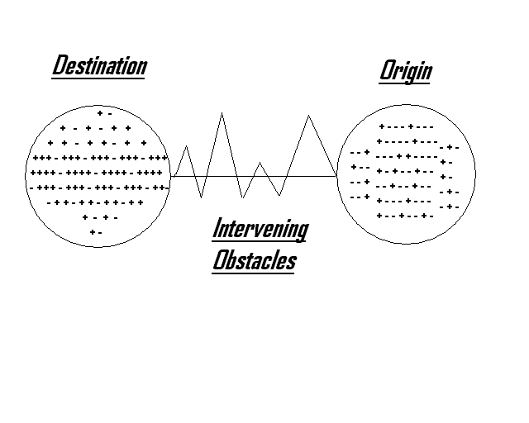
Push Pull Factors

Slide 13
An American Tail
What are the Push factors?

Slide 14
An American Tail
What are the Pull Factors?

Slide 15
An American Tail
What are the Intervening Obstacles?

